Slide 1
Sentiment Analysis on Speech
Diksha Bhushan Waghmare
BugendaiTech Data Science Intern
Team Ayush

Slide 2
Speech Data
Speech was downloaded from PIB in PDF format for year 2021 and 2022. The data cleanup was performed on it and visualized in the end. Few steps listed below
Extract the text data from pdf
Data converted to lower case
Removed the punctuations
Removed Numbers
Removed Stop words
Lemmatization
Visualized the Top 10 words data using word cloud and frequency bar plot
Visualized all the cleaned words from speech in customized word cloud
Sentiment analysis done using VADER to extract scores
The scores then visualized using doughnut plot

Slide 3
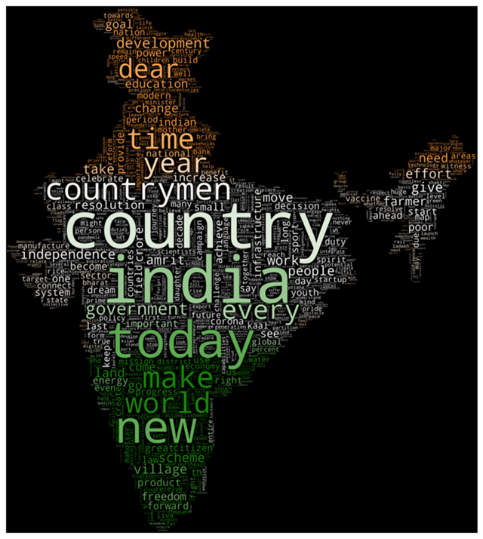
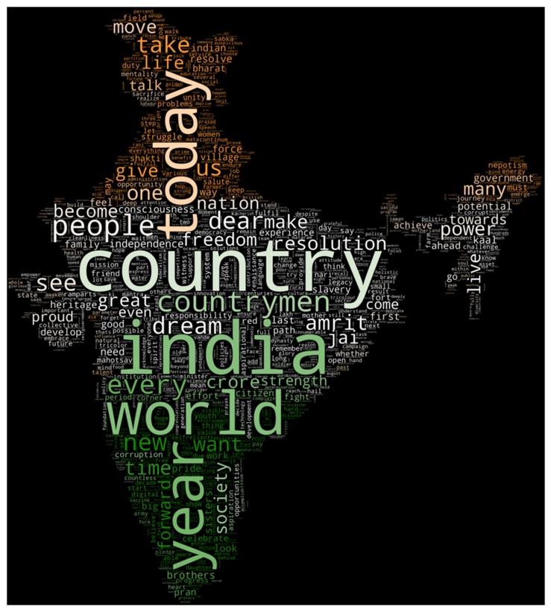
Customized Word Clouds
Year 2021
Year 2022

Slide 4
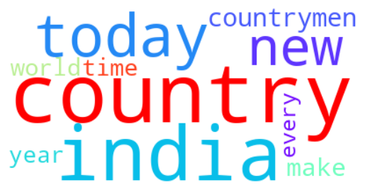
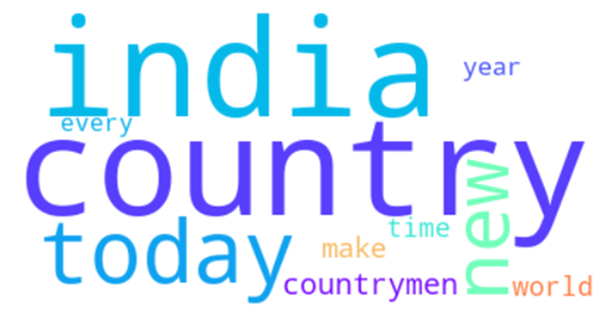
Top 10 words in word Clouds
Top 10 words are visualized from 2021 and 2022 speeches. We can observe that that Country and India are most used words in both of them.
Year 2021
Year 2022

Slide 5
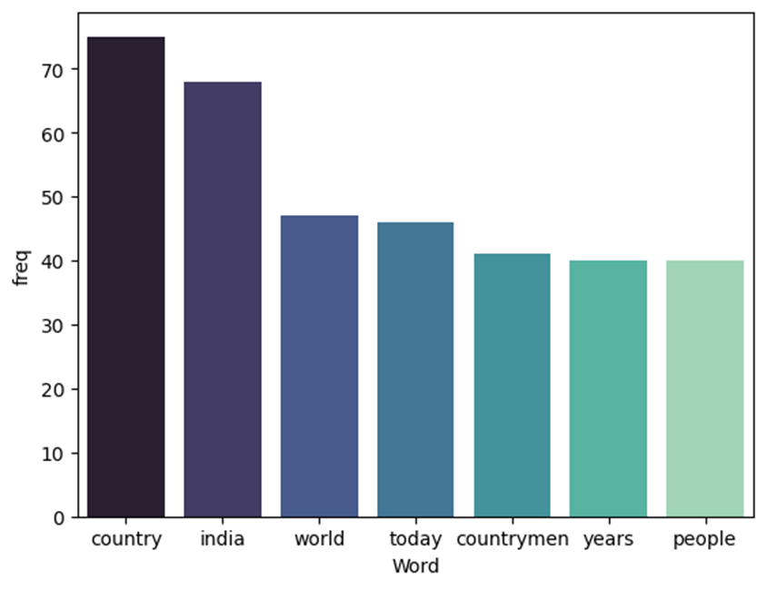
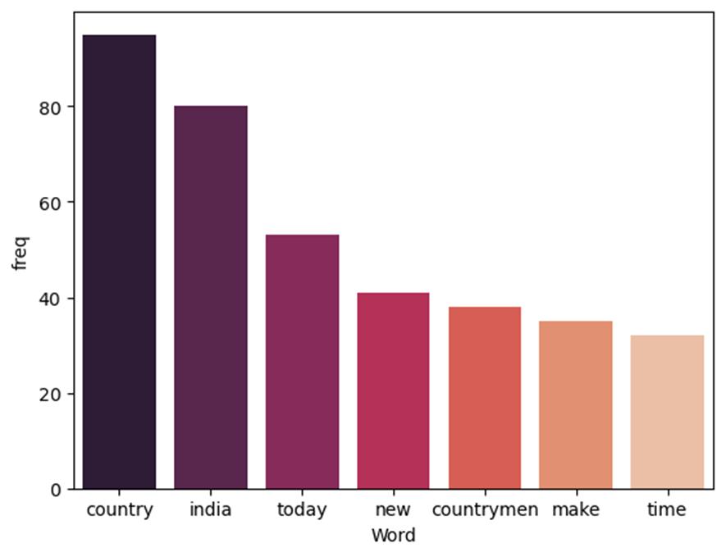
Top words frequency
The frequency for words is visualized from 2021 and 2022 speeches in bar charts. We can observe that in 2021 “world” was third highest word used and in 2022 “today” was third highest word.
Year 2021
Year 2022

Slide 6


Sentiment Analysis using TextBlob
Polarity score from textBlob for both speeches is greater than zero. It represents overall positive sentiment.
Year 2021
Year 2022

Slide 7
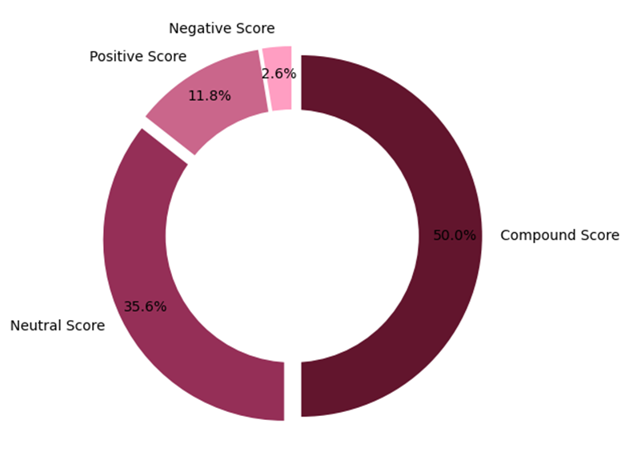
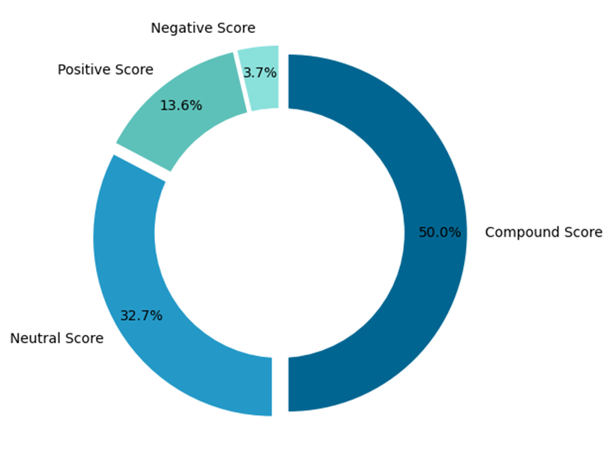
Sentiment Analysis using VADER
We can observe from the sentiment scores, positive score is greater than the negative for both year speeches. We can conclude that 2021 speech has overall positive sentiment.
Year 2021
Year 2022

Slide 8
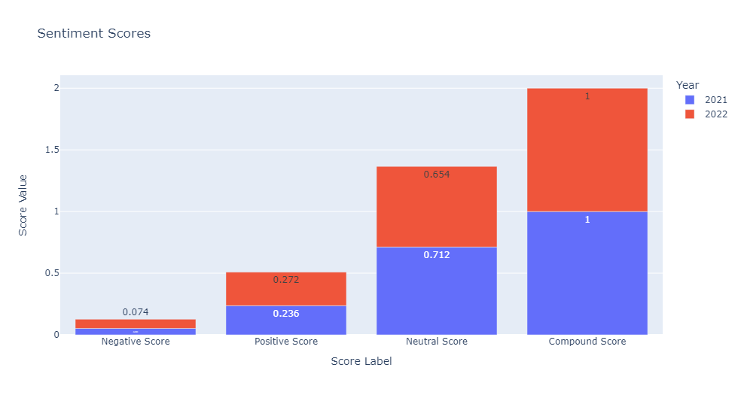
Sentiment Analysis using VADER (score comparison)
Comparing sentiment scores for both year we observe that scores are similar with positive sentiments

Slide 9
Conclusion
Downloaded the both speeches from PIB in pdf format and extracted the text.
After cleaning the data it was visualized using customized word cloud and top words used in speech found out.
Sentiment analysis was done using TextBlob and VADER on both speeches. Overall sentiment is found to be positive.

Slide 10
Thank You

